Slide 1

CASE METHODS WORKSHOP
September 24, 2020
Bernardo Piazzardi
Universidad Austral
Argentina
bpiazzardi@austral.edu.ar

Slide 2
Case method through online classes
The challenge
How to achieve interesting and productive classes for the participants…
… by using the case method…
… via online platforms…
… on pandemic times
Pleasant and productive pedagogical experience

Slide 3
Context
Understanding the participant (*)
Due to the pandemic
Emotional situation
Economic situation
Social situation
How will the future be ("new normal")
Anxiety
Uncertainty
Expectation
Human Connection !!
(*) Some key factors:
The selection criteria for the cases (**)
The sessions planning (***)
(**) Tip for selecting cases:
“Normal” agribusiness management challenges and business strategy themes + the new COVID 19 "drivers“…
(***) Tip for planning sessions:
Less is more (the use of time)

Slide 4
Commitment and involvement
1. Case selection criteria: critical for success !
2. Prior to the session
Preparing the case in advance becomes more important:
  Selection of materials for participants: Not only text!
  Guide: Adapt assignments
3. During the session:
Criteria for distributing time for the session:
Introduction to the case: no more than 15 minutes (Includes the conceptual-theoretical framework)
Break-out rooms: active presence of the professor: 25 minutes
Plenary discussion: its proper functioning depends on the balance between the flow of contributions and the concrete and balanced participation of the participants: 30 minutes Try to have the case “protagonist” on board for the plenary !!!
The takeaways will only be of value if the closing of the plenary discussion has an "impact“: 5 minutes

Slide 5
Commitment and involvement
4. Post session !!!
Send me your video !!! (one per team)
Peer review: (template for all participants to do a critique of the videos)
Final feedback: to each of the participant by the professor
Inputs for the feedback:
  Performance on the 3 stages (pre, during post sesión)
  The video and other interactions (wapp, etc)

Slide 6


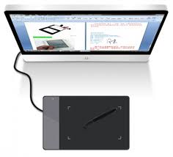



Basic tool kit
Moderator
Screens (3)
Polls
Digital writing pad
Internet connection
Contingency plan

Slide 7
Some final thoughts
Remember that the case method is participant-centered:
  Don´t push them, beware, fragile, handle with care, they (we) are under enough pressure already…
2. Achieving learning objectives:
Besides the “obvious” ones (teaching note), we should take into account that emotions are a good learning technique, specially on dire straits times…
3. Enjoy the learning experience:
You, as a professor, you should also enjoy the ride, you deserve it !!
4. Currently, we are going through difficult times, so, let´s improve life

Slide 8
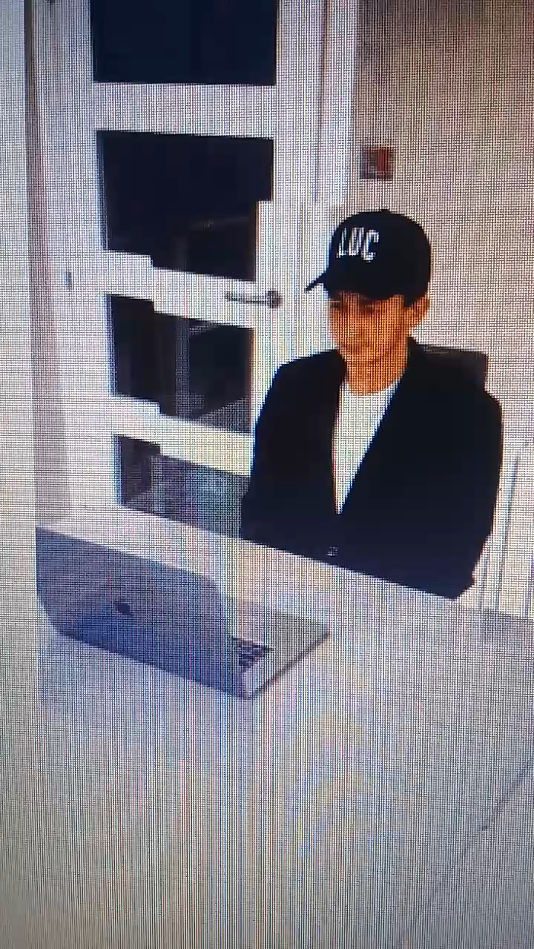

​

Slide 9
Thank you !!
CASE METHODS WORKSHOP
September 24, 2020
Bernardo Piazzardi
Universidad Austral
Argentina
bpiazzardi@austral.edu.ar

